Slide 1
Drag and Drop :
The HTML5 Power Move
-By Nagesh Kassa

Slide 2
Introduction to Drag and Drop Feature in HTML5
Allows users to move elements on a web page by clicking and dragging them with their mouse or touchpad.
makes it easier for users to interact with web pages.
It allows user to rearrange content on a page, move files between folders, and even drag and drop images into an email or document
HTML5 provides native support for the Drag and Drop feature

Slide 3
Attributes
draggable: Specifies that an element can be dragged.
ondragstart: Executes code when the drag operation starts.
ondragover: Executes code when a draggable element is being dragged over a valid drop target.
ondragenter: Executes code when a draggable element enters a valid drop target.
ondragleave: Executes code when a draggable element leaves a valid drop target.
ondrop: Executes code when a draggable element is dropped onto a valid drop target.

Slide 4
Example:
<html>
<head>
<script>
function allowDrop(ev) {
ev.preventDefault();
}
function drag(ev
ev.dataTransfer.setData("text", ev.target.id);
}
function drop(ev) {
ev.preventDefault();
var data = ev.dataTransfer.getData("text");
ev.target.appendChild(document.getElementById(data));
}
</script>
</head>

Slide 5
Example:
<body>
<p>Drag the image into the rectangle:</p>
<div ondrop="drop(event) " ondragover="allowDrop(event)"></div>
<img id="drag1" src="img_logo.gif" draggable="true" ondragstart="drag(event)" >
</body>
</html>

Slide 6
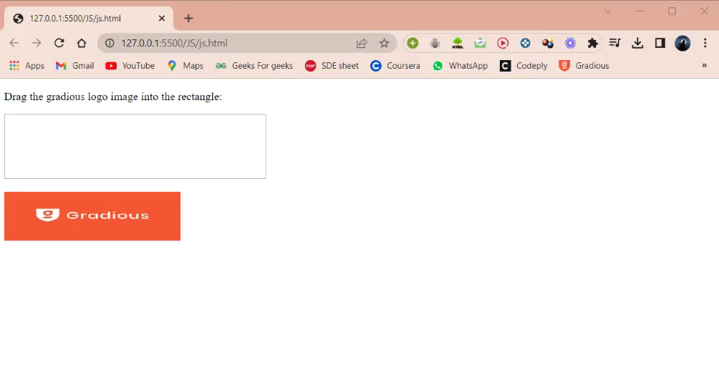
Output:

Slide 7
Applications
Showcase various use cases where Drag and Drop can enhance user experience, such as:
Reordering items in a to-do list or a playlist.
Creating interactive presentations or customizable dashboards.
Uploading files

Slide 8
Conclusion
HTML5 native support for Drag and Drop makes it easier for developers to implement this feature in web applications.
By utilizing the built-in capabilities, we can create interactive and engaging interfaces.

Slide 9



